Slide 1

ATLIQ MART | HOSPITALITY ANALYTICS
Where Revenue Is Being
Left on the Table
A data-driven story across the AtliQ Mart hotel portfolio — three insights, three business solutions, and a low-cost roadmap to lift RevPAR.
Prepared by Hiran • Power BI Resume Project (Codebasics)
Notes:
Open with the headline: across the AtliQ Mart portfolio there are three clear, low-cost opportunities to grow revenue without changing the overall pricing strategy.

Slide 2
PROBLEM STATEMENT
AtliQ Mart Hotels: Hospitality Domain
Atliq Grands owns multiple five-star hotels across India. They have been in the hospitality industry for the past 20 years. Due to strategic moves from competitors and ineffective decision-making in management, Atliq Grands is losing its market share and revenue in the luxury/business hotel category. As a strategic move, the managing director of Atliq Grands wanted to incorporate "business and data intelligence" to regain their market share and revenue. However, they do not have an in-house data analytics team to provide them with these insights. Their revenue management team has decided to hire a third-party provider to provide them with insights from their historical data.

Slide 3
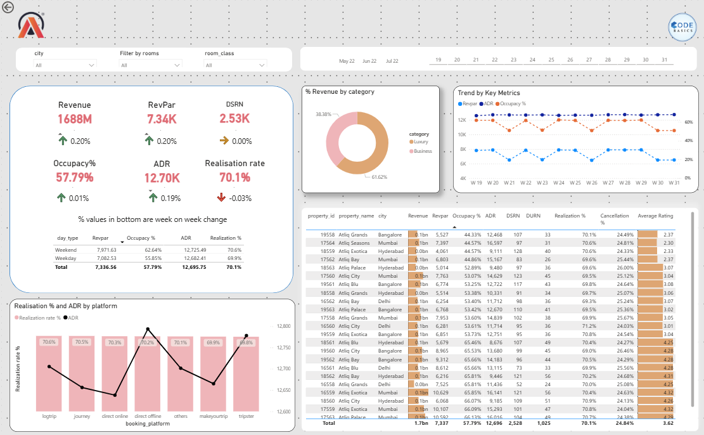
Final Dashboard

Slide 4



The Story in Three Parts
Each insight pairs a data pattern from the dashboard with a concrete, low-cost business solution.
01
02
03
Pricing Doesn't
Follow Demand
Low Ratings Are
Capping Occupancy
High-Value Bookings
Are Slipping Away
ADR stays flat regardless of occupancy swings
Guest experience, not price, is the bottleneck
Cancellations hit the highest-rate channels hardest
Notes:
Quick roadmap of the three findings before diving into each one with charts.

Slide 5

INSIGHT 01
Pricing Isn't Adapting to Demand
ADR stays remarkably flat — around 12K-13K — every single week, whether occupancy sits at 50% or 65%.
Since RevPAR = ADR × Occupancy, and ADR barely moves, RevPAR is driven almost entirely by occupancy — not by rate. High-demand weeks (W22, W24, W27-W29) and low-demand weeks (W21, W23, W26, W30-W31) are priced identically.
BUSINESS SOLUTION
Introduce demand-based pricing: small rate increases during historically high-occupancy weeks, and targeted promotions during low-occupancy weeks — using existing rooms to capture more value without new investment.
Notes:
ADR is essentially a flat line. RevPAR and Occupancy move together in lockstep — point out the matching dips at W21, W23, W26, W30-31 across both charts.

Slide 6
INSIGHT 02
Low Guest Ratings Are Quietly Capping Occupancy
Atliq Grands Bangalore charges rates comparable to top-performing properties, but its 2.37 average rating leaves it stuck at just 44.33% occupancy.
Rating vs. Occupancy — Selected Properties
Atliq Grands, Bangalore
2.37★
44.3%
Even the weekend bump (47.92% occupancy) compared to weekdays (42.89%) follows the normal pattern — but both numbers sit well below the portfolio average. Since pricing is competitive, the gap isn't a pricing problem. It's a guest experience problem: poor reviews are turning potential guests away before they even book.
Atliq Bay, Mumbai
2.37★
44.9%
Atliq Palace, Hyderabad
3.07★
52.9%
Atliq City, Bangalore
4.28★
65.5%
BUSINESS SOLUTION
Prioritize service quality reviews for any property rated below 3.0. Improving the guest experience at these locations is likely to lift occupancy more effectively than any pricing change.
Atliq Blu, Hyderabad
4.25★
65.5%
Bar = average guest rating (out of 5) | % = overall occupancy
Notes:
Walk through the pattern: properties rated below 3 sit at 44-53% occupancy, properties rated above 4 sit at 65%+ — despite similar pricing.

Slide 7
INSIGHT 03
The Highest-Value Bookings Are Slipping Away
Tripster bookings carry the highest average rate (ADR 12,778) but the lowest realization rate (69.8%) of any channel.
Realization rate = 1 - (Cancellation % + No-show %). A lower realization rate means more of that channel's bookings are cancelled or never arrive. Since Tripster's bookings are also the most expensive, every cancellation here represents the biggest possible revenue loss per booking.
BUSINESS SOLUTION
Introduce stricter cancellation policies (e.g. deposits) for Tripster bookings specifically. Because these are the highest-value bookings, even a small improvement in realization here recovers more revenue than the same gain on lower-ADR channels.
Notes:
Point out: Tripster has both the highest ADR and the lowest realization rate — the worst combination for revenue leakage.

Slide 8
Key Takeaways and project Learnings
None of these insights came from a single metric. They showed up when I compared two metrics at a time, and each one pointed toward a low-cost, high-impact fix. The skill isn’t about doing more; it’s about finding the right combination that points straight to a better decision.
Together, these three actions form a roadmap for improving RevPAR across the AtliQ Mart portfolio — by adjusting prices to match demand, fixing service issues that drive guests away, and protecting the bookings that matter most.
Notes:
Close on the unifying theme: smarter use of existing data, not new spend.

Slide 9
Thank You
Built using Power BI, DAX, and a star-schema data model on the AtliQ Mart hospitality dataset (Codebasics Resume Project Challenge).
Hiran
Shipping Executive → Data Analyst in progress
Notes:
End with a call to action — connect on LinkedIn or check out the portfolio.

